Slide 1
Interfacing Raspberry Pi3 with Node-RED
CS5590-490-IOT/Cognitive Robot Programming

Slide 2
Installing Raspbian OS on RaspberryPi3 https://projects.raspberrypi.org/en/projects/noobs-install

Slide 3
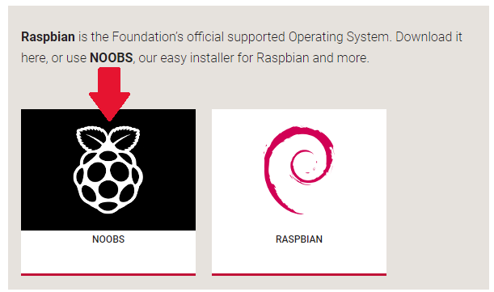
Steps to Download NOOBS Installer
Using NOOBS is the easiest way to install Raspbian on your SD card. To get hold of a copy of NOOBS:
www.raspberrypi.org/downloads/
You should see a box with a link to the NOOBS files. Click on the link
The simplest option is to download the zip archive of the files.

Slide 4
Steps to Install Raspbian on PI
Format the SD card
Extract NOOBS from the archive
Navigate to the SD card and select all the files from the NOOBS folder and drag them onto the SD card
Once the files have been copied over, insert the micro SD Card into your Raspberry Pi, and plug the Pi into a power source
You will be offered a choice when the installer has loaded. You should check the box for Raspbian, and then click Install

Slide 5
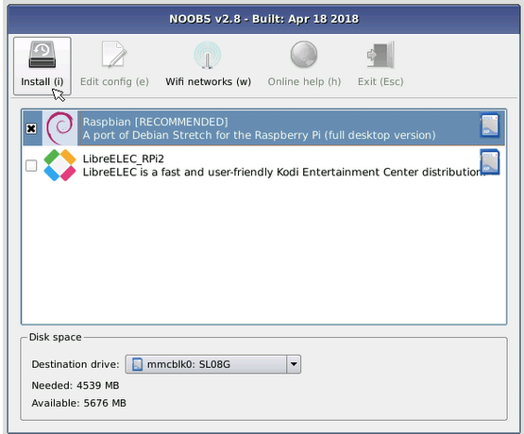
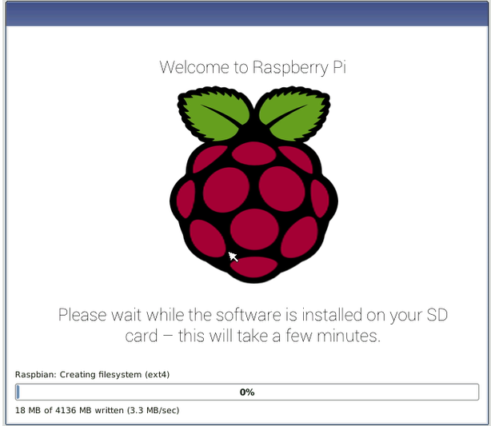
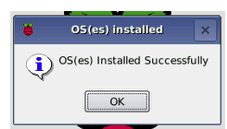
Completing OS Installation

Slide 6
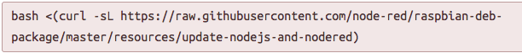
Running Node-RED on Raspberry PI
If you have a version of Raspbian that doesn’t have Node-RED already installed, you can install or upgrade using the Node-RED upgrade script command
On the Desktop, select Menu -> Programming -> Node-RED
or run node-red-start in a new terminal window.
Note:
To stop Node-RED, run the command node-red-stop.
To see the log, run the command node-red-log.
https://nodered.org/docs/hardware/raspberrypi

Slide 7
Interacting with the Pi hardware
There are several ways of interacting with a Raspberry Pi using Node-RED.
rpi-gpio nodes (default) provided in the palette for monitoring and controlling the GPIO pins. This is the simplest and recommended method.
contrib-gpio nodes (optional) additional nodes from @monteslu that provide generic gpio support for Pi, BeagleBone, Arduino, Edison, etc.
wiring-pi module (advanced) this provides more complete access to the GPIO pins, and other devices, within Function nodes. This gives more control and access to other features not in the nodes but you have to program it yourself.

Slide 8
Agenda
How to set up Node-RED flows
How to control GPIO pins with Node-RED
How to use Node-RED inputs, outputs and a switch (equivalent to a selection statement)
Using Node-RED to simulate a NOT gate acting upon input from a button

Slide 9
Hardware
Raspberry Pi
1 x LED
1 x Solderless breadboard
4 x Male-to-female jumper leads
1 x 330R resistor
1 x Tactile push button

Slide 10
GPIO Pins
GPIO stands for General-Purpose I/O
Also these pins are a physical interface between the Raspberry Pi and the outside world.
These pins are used to connect the Raspberry Pi to electronic circuits, which allow it to control and monitor the outside world like turning LEDs on or off, run motors, and perform many other actions.

Slide 11
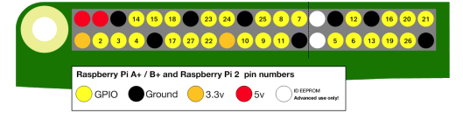
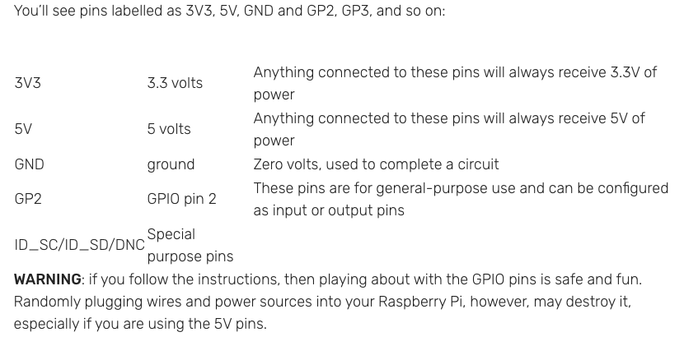
There are 40 pins

Slide 12
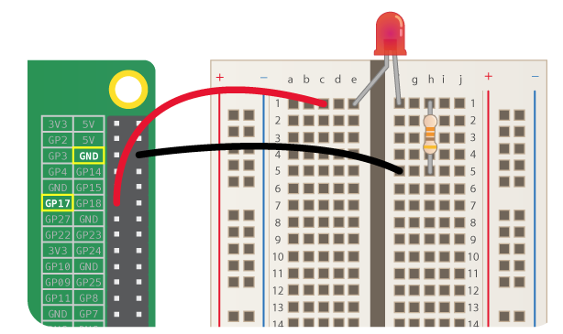
Wire up the LED
Wire up an LED to GPIO pin 17 on your Raspberry Pi by following this diagram:
The positive leg of the LED is usually longer, and it is this leg which should be inserted into the left side of the breadboard [e1 on the diagram].

Slide 13
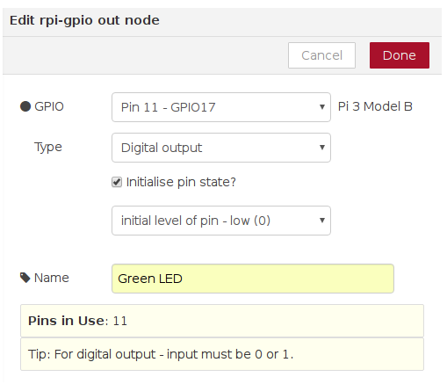
Steps
Make sure you download the raspberry gpio nodes from the Node-RED palette
Drag a rpi-gpio out node and configure as follows

Slide 14
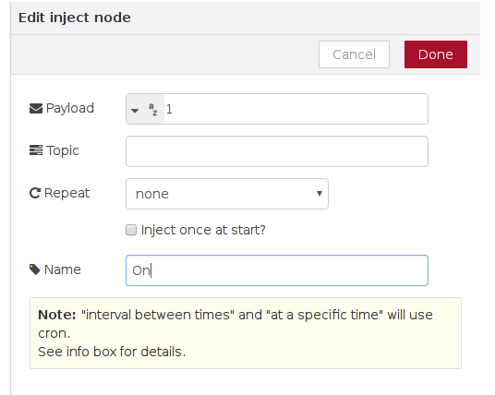
3. Drag an inject node and configure it as follows:

Slide 15
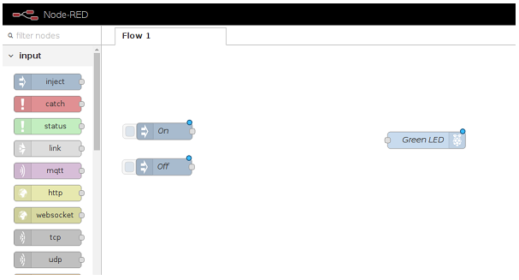
4. Repeat the previous steps to create another inject node, except this time add 0 as the payload message, and call this node Off

Slide 16
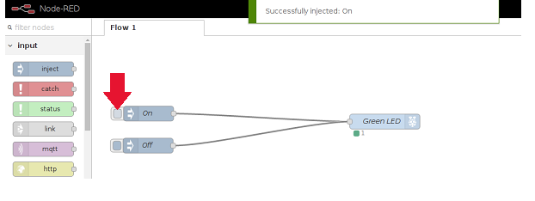
Final Flow

Slide 17
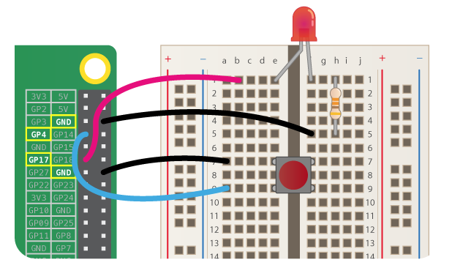
Small Exercise
Make changes to the flow to turn on/off the LED using button
https://projects.raspberrypi.org/en/projects/getting-started-with-node-red/11

Slide 18
Extra Exercise
Connect DHT22 Temperature/Humidity Sensor for Visualization on Raspberry PI
Hints
YouTube: https://www.youtube.com/watch?v=8xyMKAJxDvg
https://flows.nodered.org/node/node-red-contrib-dht-sensor
http://www.airspayce.com/mikem/bcm2835/

Slide 19
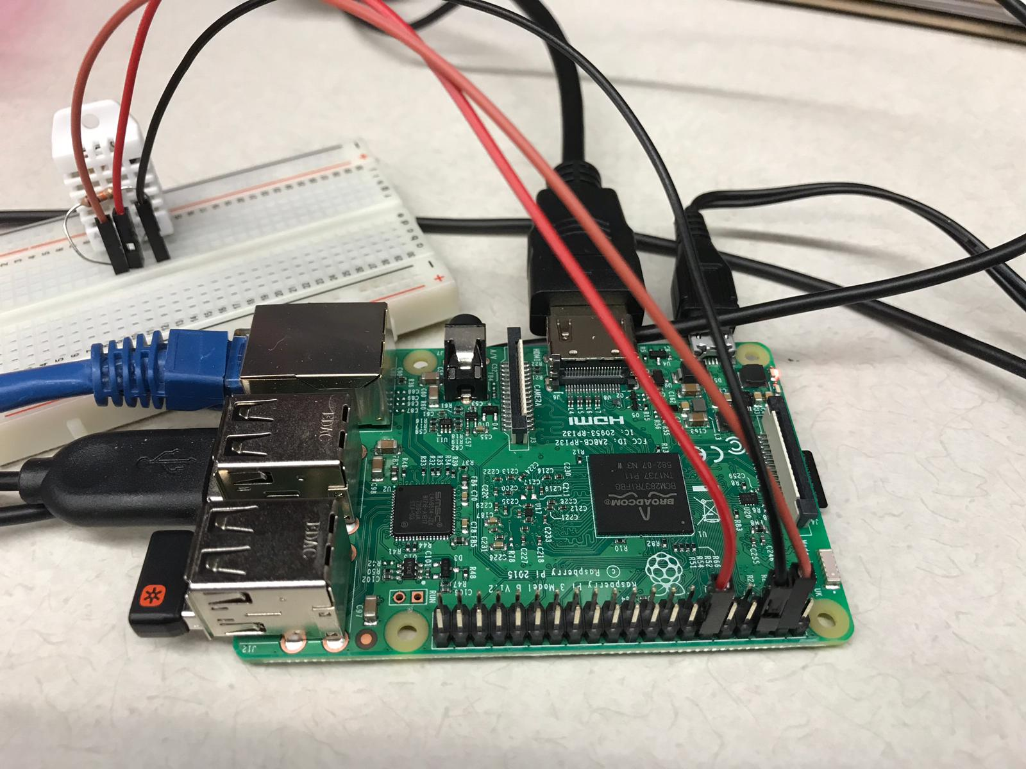
Connections

Slide 20
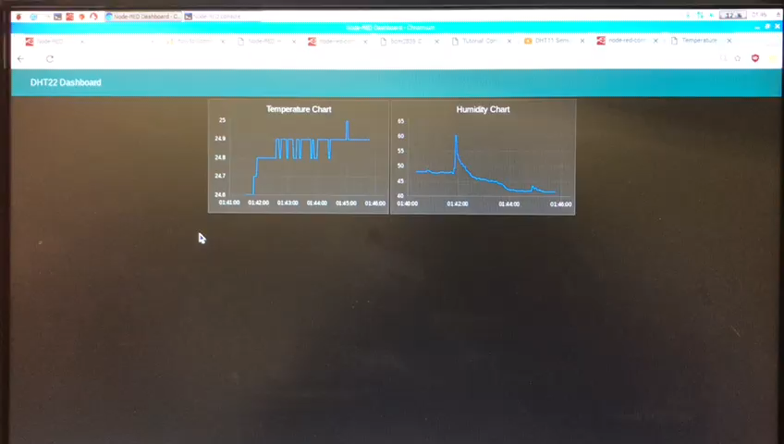
Demo

Slide 21
Steps to Connect to Laptop
Initially, Turn on Hotspot on your laptop
Steps to do on PI
Connect PI with the Hotspot
Start VNC server on your PI
Enable SSH
Steps to do on your laptop
Install cmder
Install VNC Client
Identify your PI IP address
Connect it using IP address on the VNC Client

